Slide 1
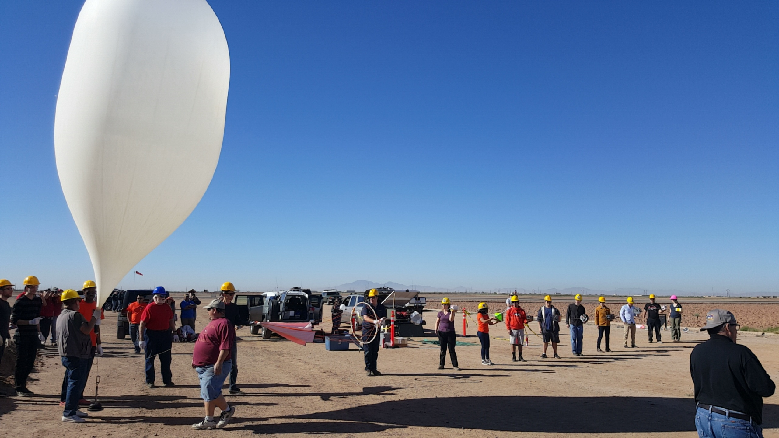
ASCEND Balloon Launch
Team Too Loud
Juan Carlos Villegas
Angel Diaz Jerome Dumas
Ryan Lindale Jacob Miranda

Slide 2
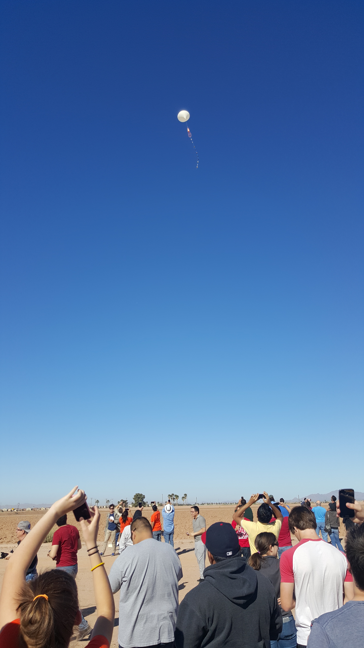
Our Flight & Goals
Balloon was a 300-gram Latex weather balloon, Filled with hydrogen. It burst at 96,577 feet.
Be under Weight
Successful launch (Main Sensors)
CO2 Sensor
RF Signal Strength
Geiger Counter
Bluetooth between both Payloads
Goal Not Accomplished
Goal Accomplished

Slide 3
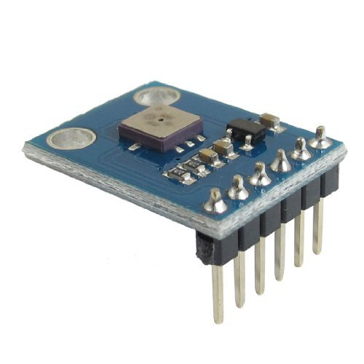
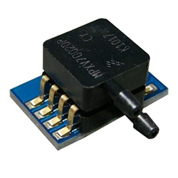
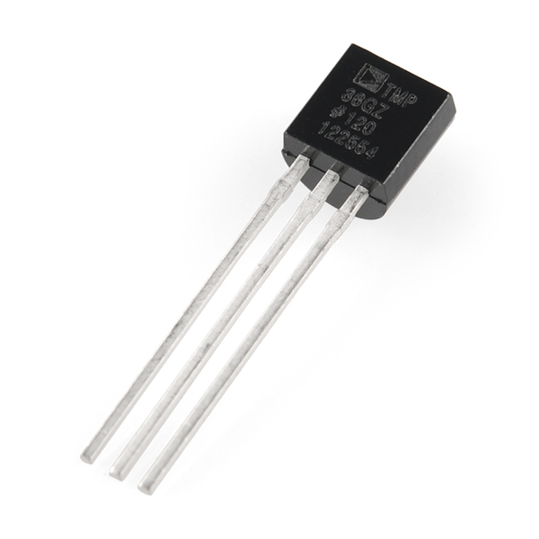
Main Sensors
Interior & Exterior Temperature
Interior & Exterior Pressure
Acceleration
* All sensors collected Data.

Slide 4
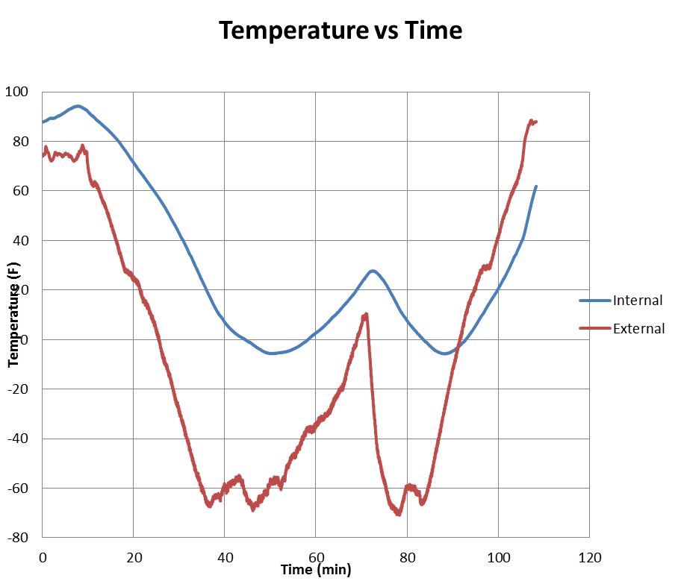
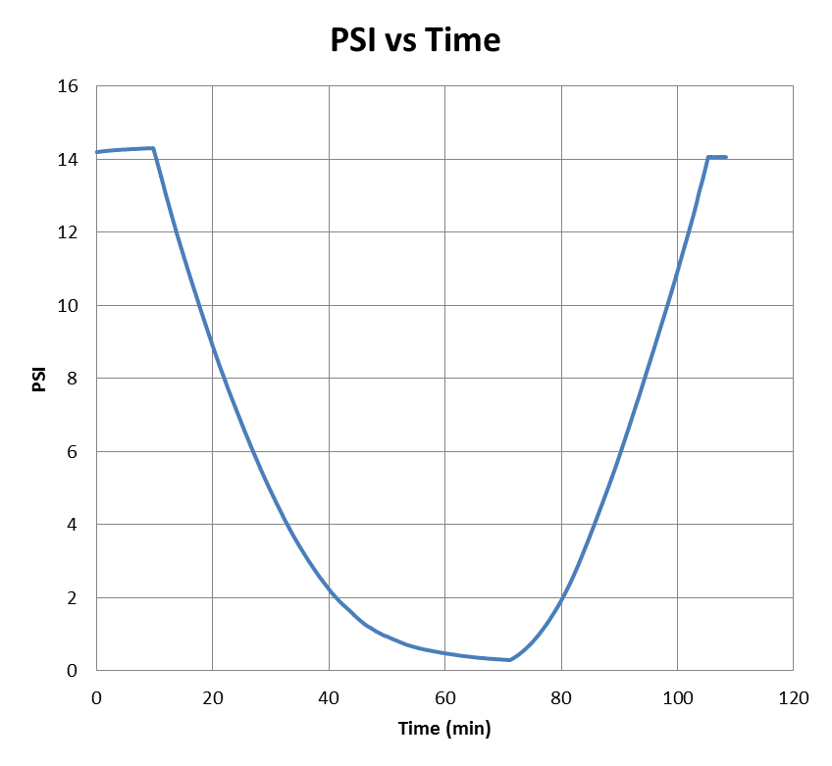

Slide 5
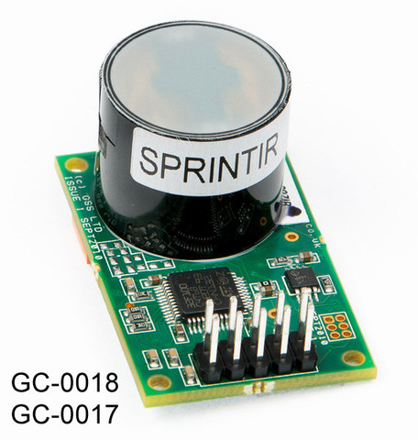

$${CO}_{2} Sensor$$
Measurement range: 20% or 100%
Weight 8 grams w/ tube cap 29 grams
Serial communications 9600/8/1/N
Sensing Method: NDIR (Nondispersive Infrared) with Gold-plated optics
Sensor Data:
All test reading were around a 350 ppm
Data received was Z 000010 we do not know what
made the sensor read this reading

Slide 6
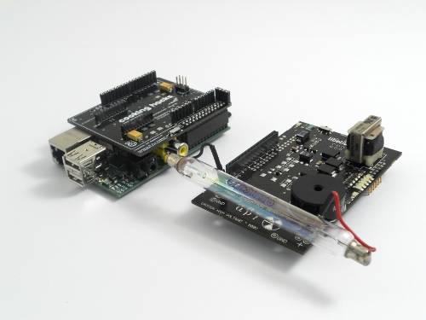
Geiger Counter
Waspmote Radiation Sensor Board and Geiger Tube

Slide 7
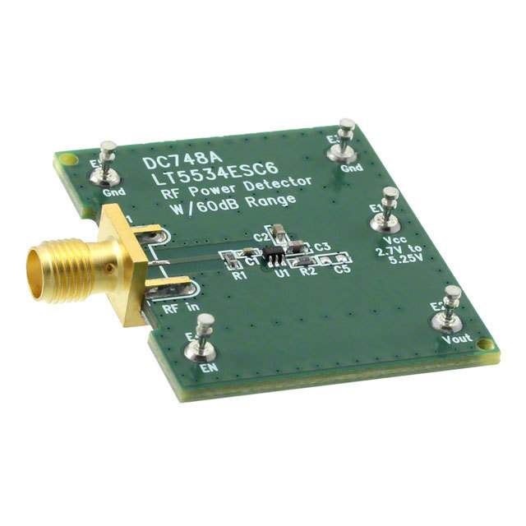
RF Power Detector
Measure Relative Signal Strength
FM Band (100MHz)

Slide 8
Expected
Fluctuation With Change in Altitude
Results
RF Strength is Constant at Various Altitudes

Slide 9
Lessons Learned from our Problems
Time Management
Arduino Analog and Digital Sensor Set Up
Writing Code and Re-writing Code
Working TOGETHER to get tasks complete
Managing our whole project and meeting our goals
Testing and Calibration with time to Test and Calibrate again

Slide 10


